Slide 1
COMPANY OVERVIEW

Slide 2
About us
Founded in 2011. Delta Reality (formerly DivIT) is a company specialized in extended realites such as VR, AR and MR.
The company consist of 25 people and offers range of services such as software & game development, 3D art & animation, R&D and production management.

Slide 3
Company profile
100+ delivered projects
63
satisfied clients
8 awards

Slide 4
Company structure
8 3D artists
12
software engineers
5 management

Slide 5
WE CREATE
AUGMENTED REALITY
VIRTUAL REALITY
MIXED REALITY

Slide 6
Our services
VR development
AR development
AI development
Computer vision development
Game development
experience design
mobile app development
3D art design
UX/UI design
sound design
video editing
rigging
animation
production management

Slide 7
3D art specialities
low poly modeling
high poly modeling
sculpting
texturing
character modeling
rigging
animation
hard surface modeling
models for real time (game engines)
models for renders
models for 3d print
compositing
environment art
photogrammetry
retopology

Slide 8
Software engineer specialities
physics development
VR & AR development
game development
computer vision
face tracking
machine learning
mobile app development
R&D

Slide 9
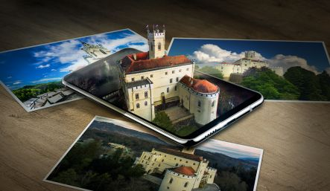
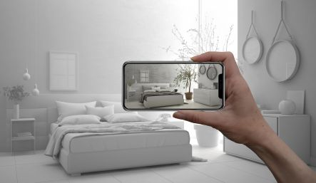
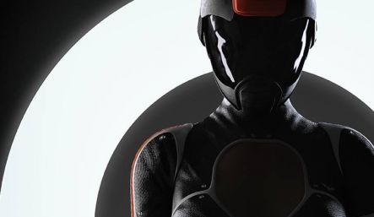
WE WORK IN...
TOURISM AND CULTURE
MARKETING
INDUSTRIAL

Slide 10
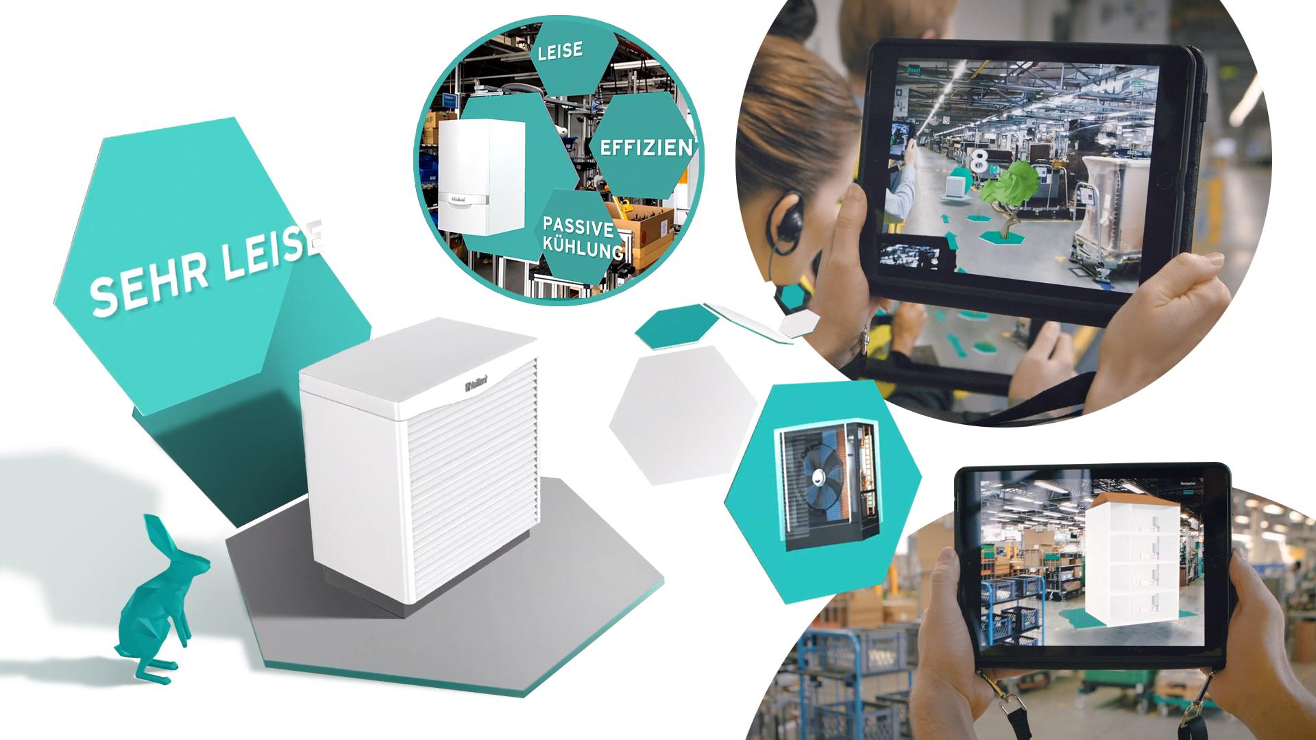
PROJECT LINK

Slide 11
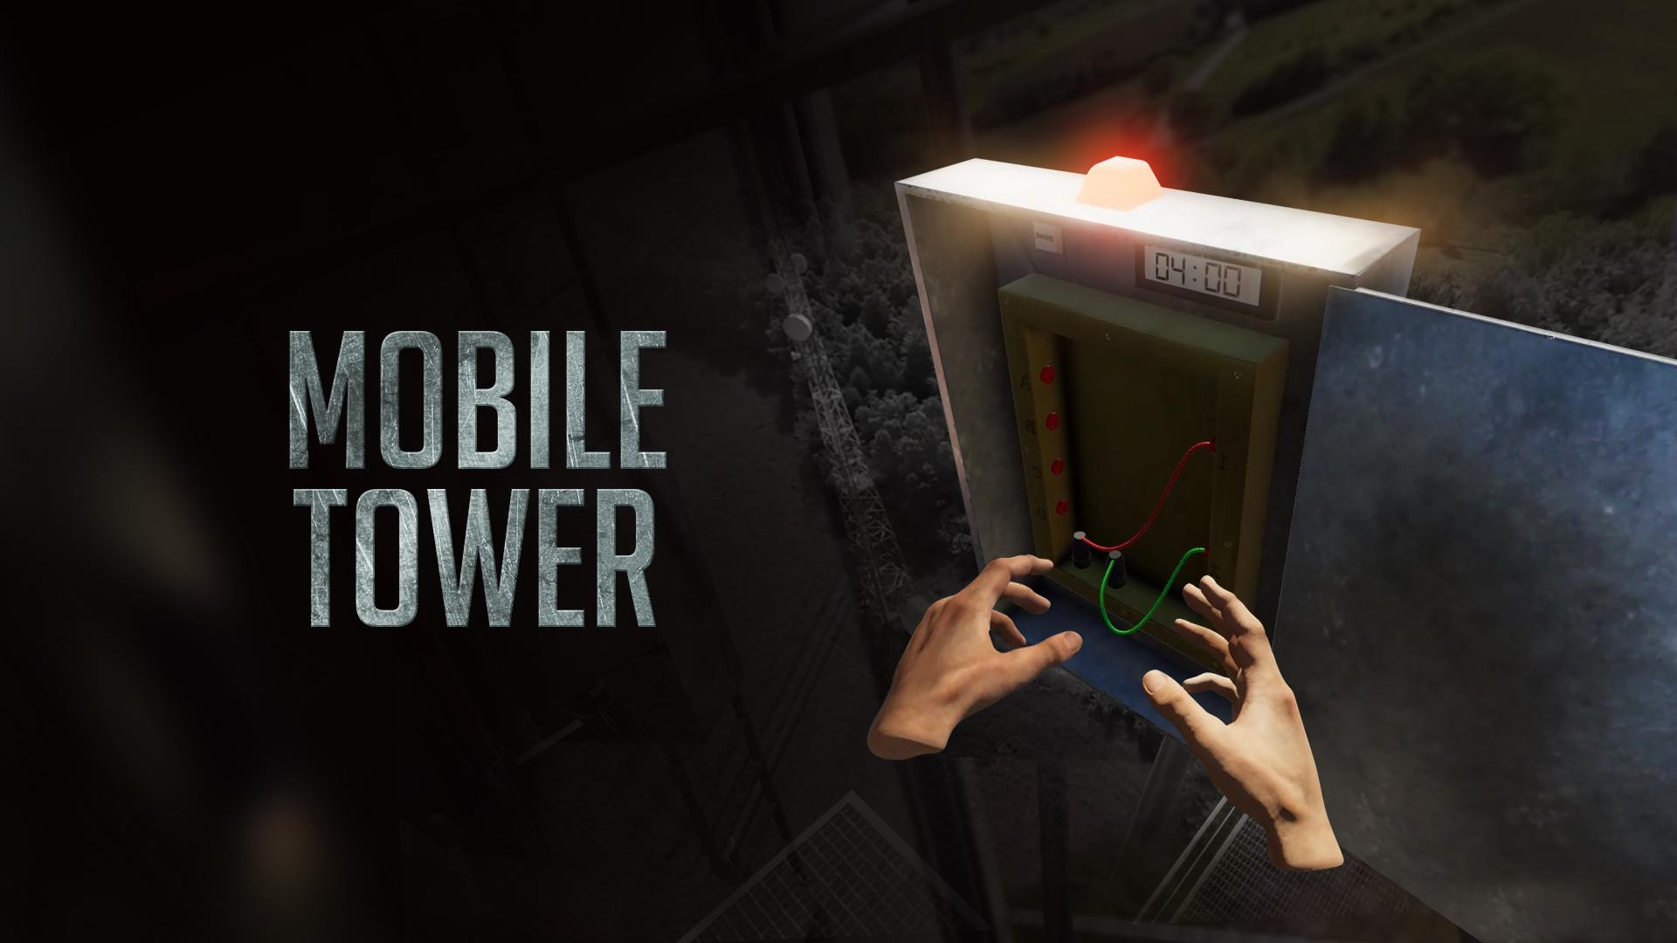
PROJECT LINK

Slide 12
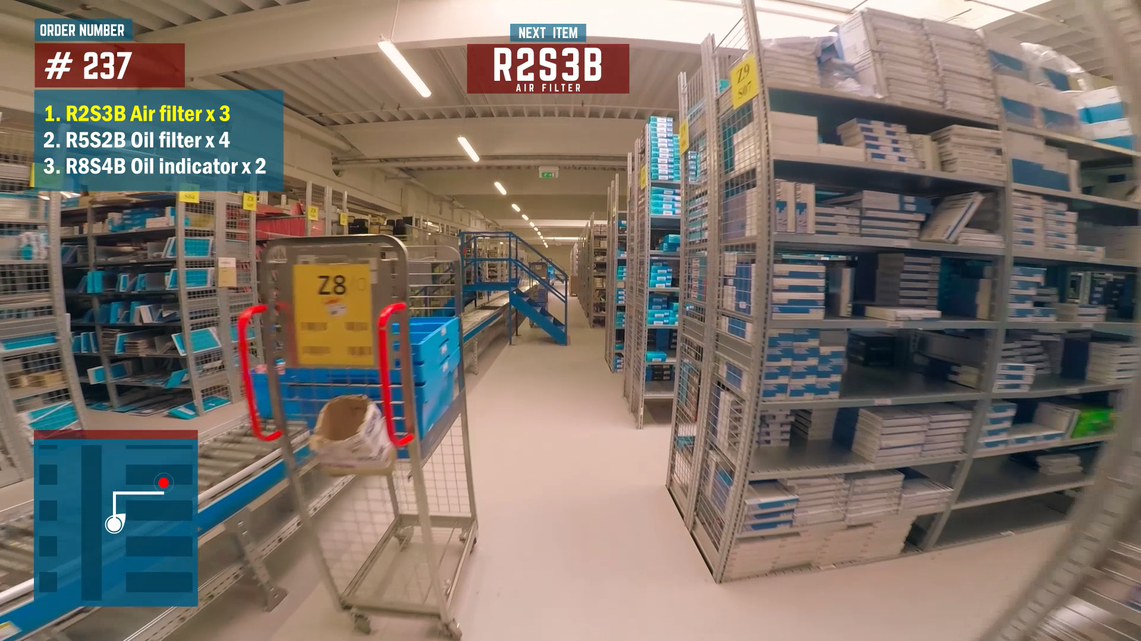
PICK BY VISION SOLUTION (WIP)
VIDEO LINK

Slide 13
Some of our clients

Slide 14
Thank You
CONTACT INFORMATION
https://deltareality.com/
JAKE@DELTAREALTY.COM

